Slide 1
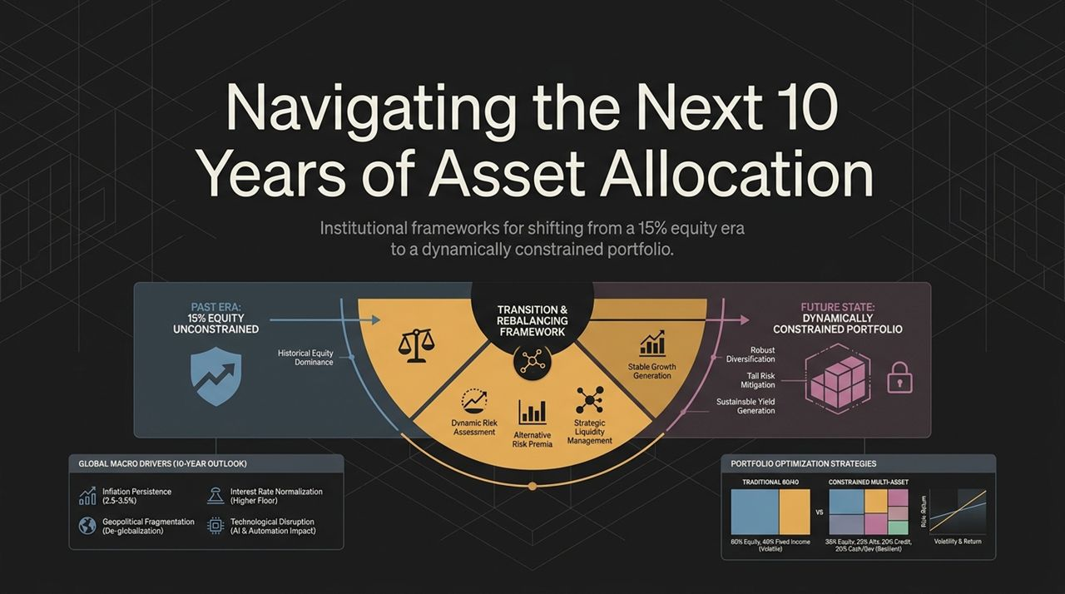
Notes:
Welcome everyone. Today we are stepping back from short-term market noise to address a structural shift in global asset allocation over the next decade.
Over the past 15 years, investors enjoyed an era dominated by 15% annualized U.S. equity returns. That era was an anomaly driven by low interest rates, stellar corporate earnings, and valuation expansion.
As we look ahead, four global macro drivers are reshaping the market landscape: Inflation persistence (2.5–3.5%), Geopolitical fragmentation/de-globalization, Interest rate normalization with a higher yield floor, and Technological disruption from AI and automation.
To navigate this environment, institutional portfolio management must transition from an unconstrained equity-heavy mindset into a Dynamically Constrained Portfolio designed for robust diversification, tail risk mitigation, and sustainable yield.
https://www.youtube.com/watch?v=pliV8FIi0YE

Slide 2
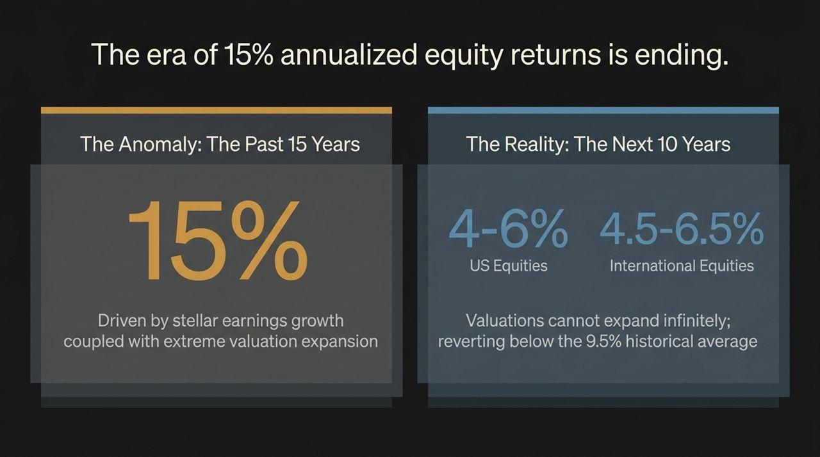
Notes:
The Anomaly (Past 15 Years): U.S. equities delivered ~14–15% annualized returns. This was fueled by extraordinary corporate earnings growth coupled with extreme valuation expansion.
The Reality (Next 10 Years): Vanguard’s 10-year Capital Market Model projects U.S. Equities to yield 4.0%–6.0% annualized and International Equities at 4.5%–6.5%.
Why the drop? Valuations cannot expand indefinitely. They historically revert toward their long-term mean (~9.5%). Even with solid corporate earnings ahead, multiple contraction will drag down total U.S. equity returns.

Slide 3
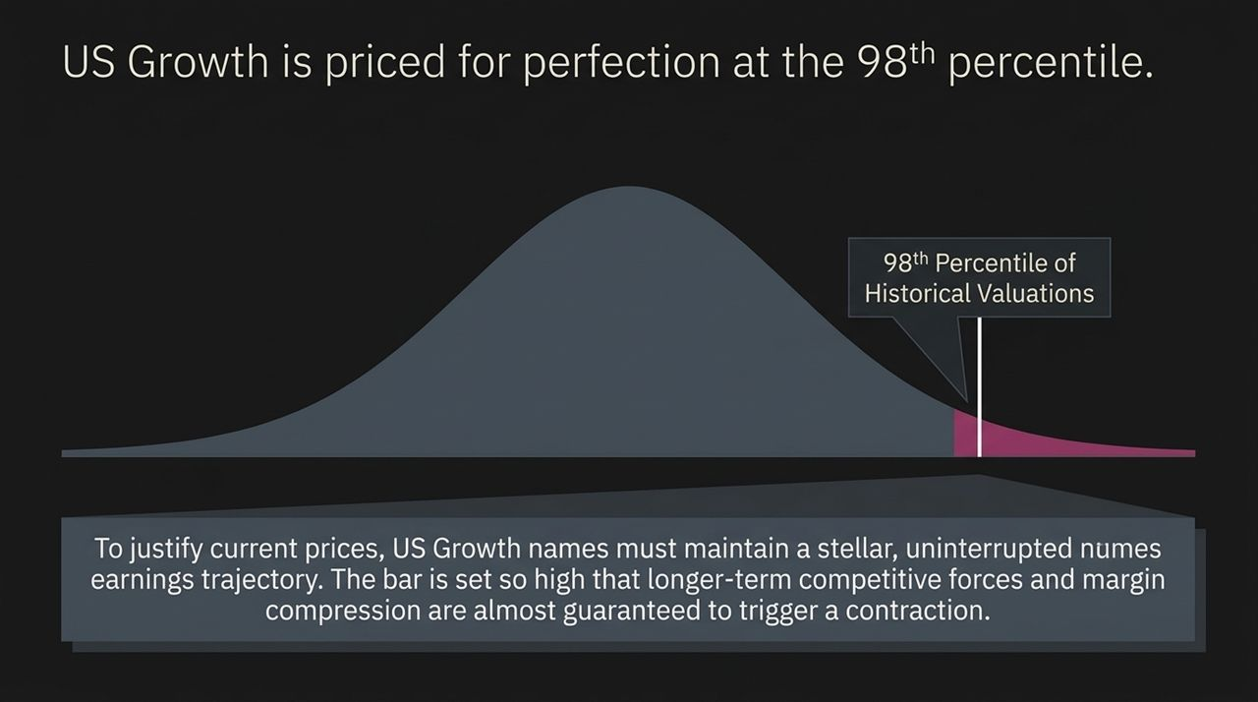
Notes:
U.S. Growth stocks are currently priced at the 98th percentile of historical valuations.
Being at the 98th percentile means market expectations are set for absolute perfection. Growth names must deliver uninterrupted, stellar earnings growth year after year.
Longer-term competitive forces, market saturation, and margin compression make this trajectory nearly impossible to sustain without triggering a valuation contraction.

Slide 4
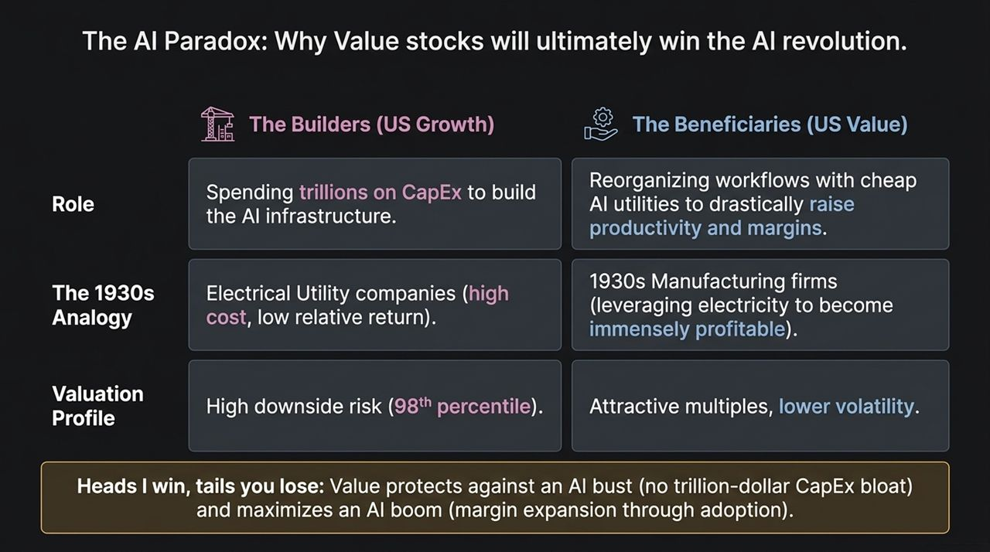
Notes:
The Builders (U.S. Growth): Spending trillions in capital expenditures (CapEx) to construct AI infrastructure.
The Beneficiaries (U.S. Value): Reorganizing workflows using cheap AI utilities to raise operational productivity and boost net margins.
The 1930s Analogy: During the electrification era, owning electrical utility companies (the builders with high costs and low relative returns) was inferior to owning manufacturing firms that leveraged cheap electricity to become immensely profitable.
Heads I Win, Tails You Lose: A Value tilt protects against an AI CapEx bust (no trillion-dollar balance sheet bloat) while maximizing upside in an AI boom through productivity adoption.

Slide 5
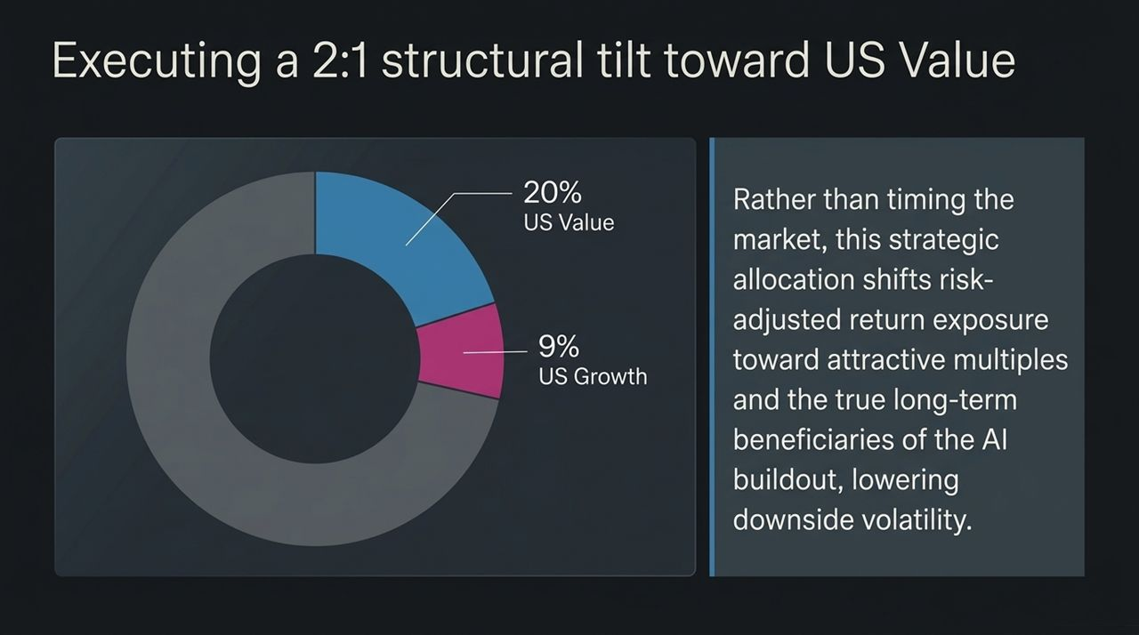
Notes:
We recommend executing a structural tilt: 20% US Value versus 9% US Growth (a >2:1 ratio).
This is not market timing—it is a risk-adjusted positioning move.
By overweighting Value, we shift exposure away from hyper-inflated multiples toward cheaper valuation multiples and capture the true long-term beneficiaries of AI productivity, significantly lowering portfolio drawdown risk.

Slide 6
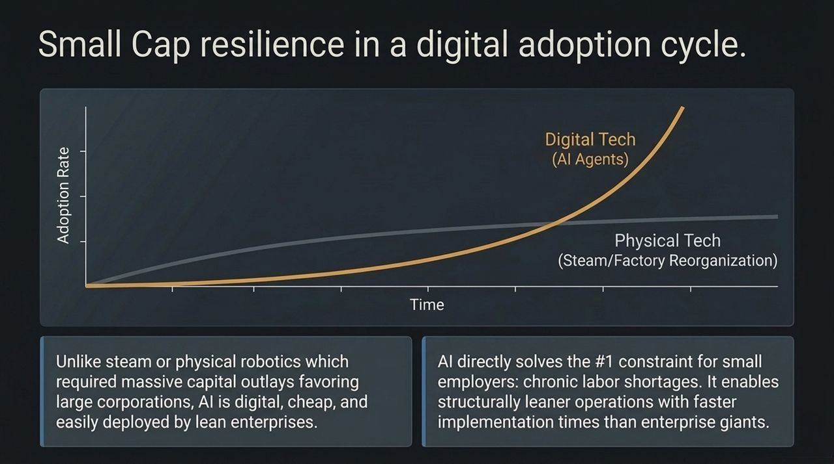
Notes:
Physical vs. Digital Tech: Steam engines and factory electrification required massive physical capital outlays that favored large enterprise conglomerates. AI software and agents are digital, inexpensive, and rapidly deployable.
Solving the Labor Constraint: The primary headwind for small businesses is chronic labor shortages and high hiring costs. AI agents allow small enterprises to operate structurally leaner and innovate without expanding headcount.

Slide 7
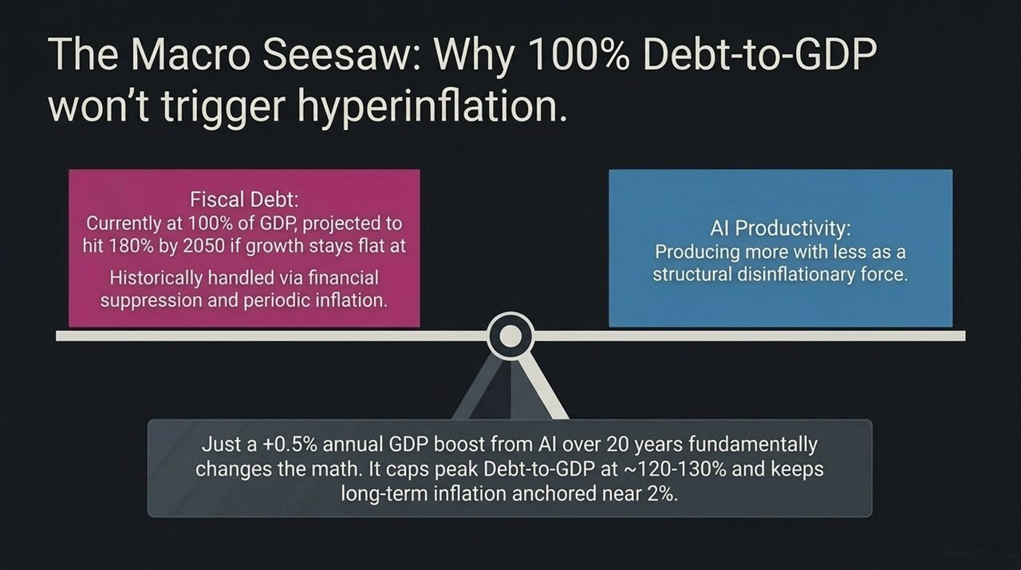
Notes:
Fiscal Debt: U.S. debt-to-GDP is at 100% and projected to reach 180% by 2050 under baseline trends. High debt historically leads to financial suppression or inflationary pressures.
AI Productivity as a Disinflationary Force: Productivity is "producing more with less"—the fundamental counterforce to inflation.
The Math Shift: A modest +0.5% annual GDP contribution from AI over 20 years caps peak Debt-to-GDP at ~120–130% and keeps baseline inflation anchored near 2%.

Slide 8
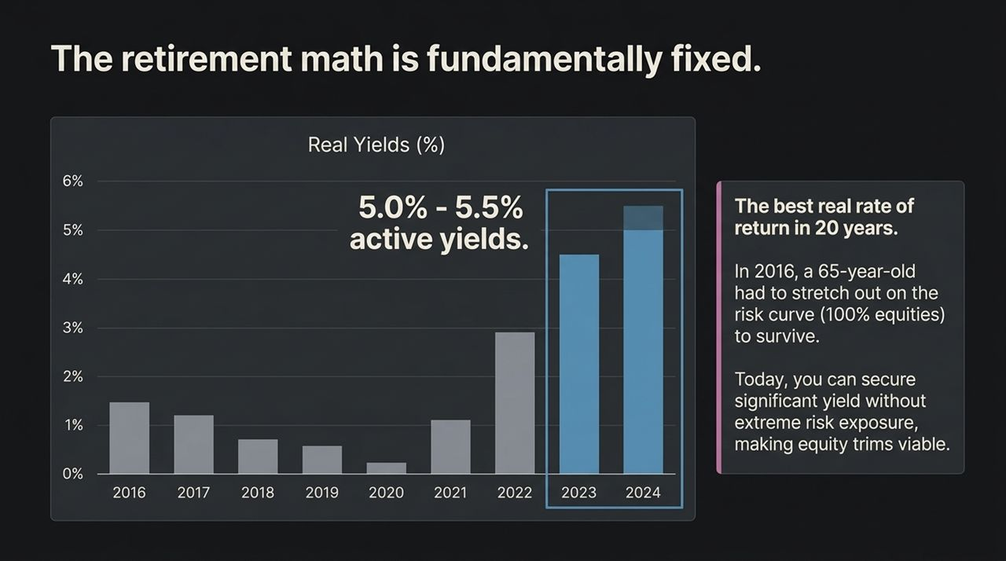
Notes:
2016 vs. Today: In 2016, real yields were near zero. A retiree had to force assets into high-risk equities just to generate income.
Active Yields at 5.0%–5.5%: Fixed income now delivers the highest real yields in almost 20 years.
Derisking Portfolios: Investors approaching or in retirement no longer need to stretch out on the risk curve. Locking in 5%+ yields allows for equity trimming while maintaining cash flow.

Slide 9
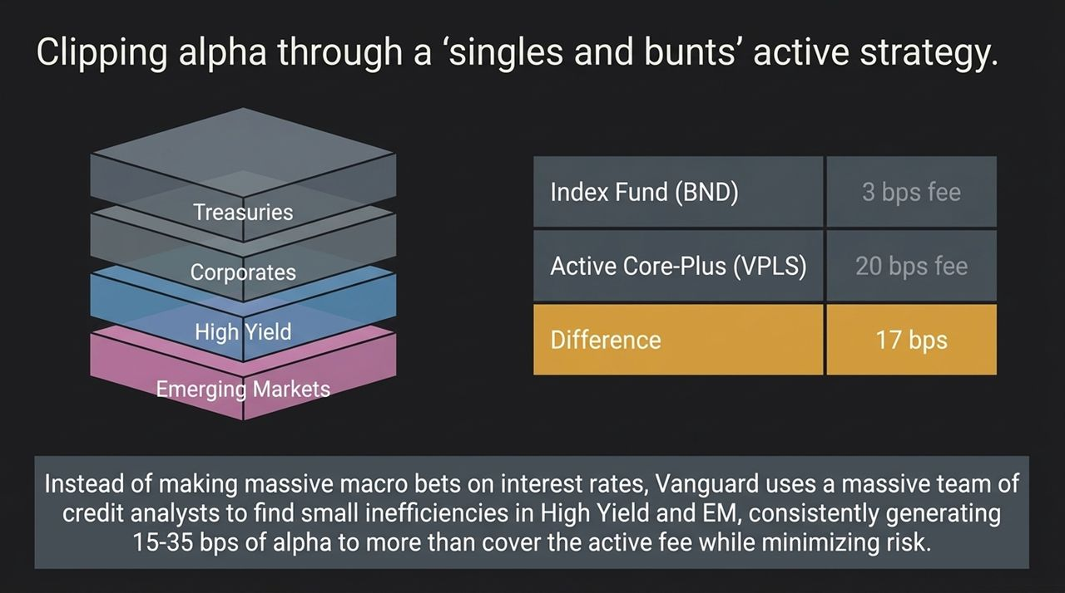
Notes:
Passive (BND) vs. Active Core-Plus (e.g., VPLS): BND charges 3 bps; active Core-Plus charges ~20 bps (a 17 bps differential).
Philosophy — Singles & Bunts: Rather than making risky, macro interest-rate bets, active management uses credit analysts to find small pricing inefficiencies in High Yield and Emerging Markets.
Net Positive Yield: Generating 15–35 bps of alpha comfortably clears the active fee while maintaining high credit quality and low downside risk.

Slide 10
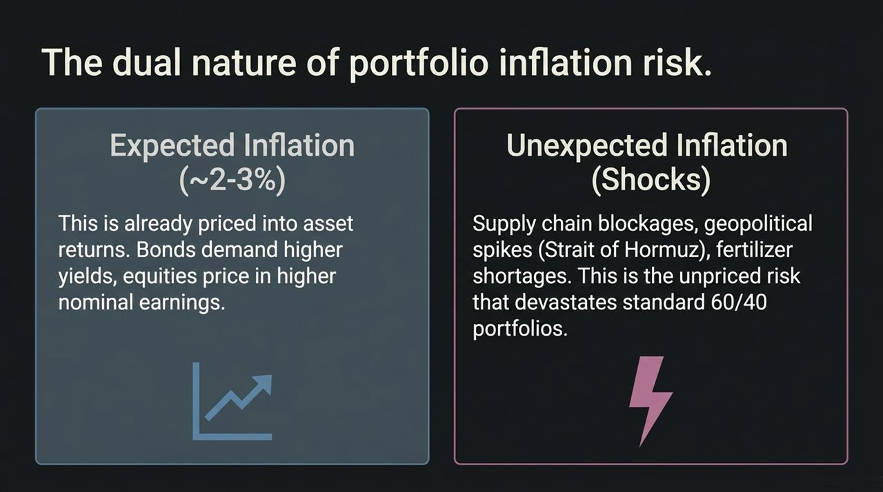
Notes:
Expected Inflation (~2–3%): Already priced into markets. Bonds demand higher nominal yields, and equities price in higher earnings.
Unexpected Inflation (Shocks): Supply chain blockages, geopolitical spikes (e.g., Strait of Hormuz closure), or agricultural shocks.
Unexpected inflation is unpriced risk that severely harms traditional 60/40 portfolios.

Slide 11
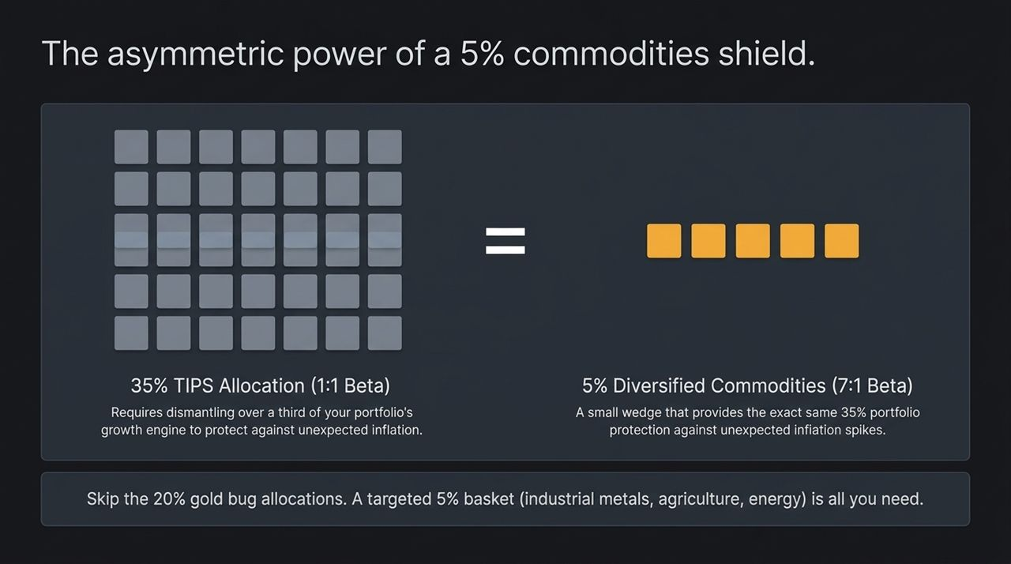
Notes:
Short-Term TIPS (1:1 Beta): Protecting 35% of a portfolio against unexpected inflation using TIPS requires reallocating 35% of total capital, dismantling the portfolio's growth engine.
Diversified Commodities (7:1 Beta): Commodities exhibit a ~7:1 beta relative to unexpected inflation shocks.
Capital Efficiency: A small 5% commodity sleeve provides the exact same portfolio-level inflation protection as a 35% TIPS allocation.
Broad Basket, Not Pure Gold: Avoid 20% single-asset bets in gold or silver. Use a diversified basket across energy, industrial metals (AI infrastructure buildout), and agriculture.

Slide 12
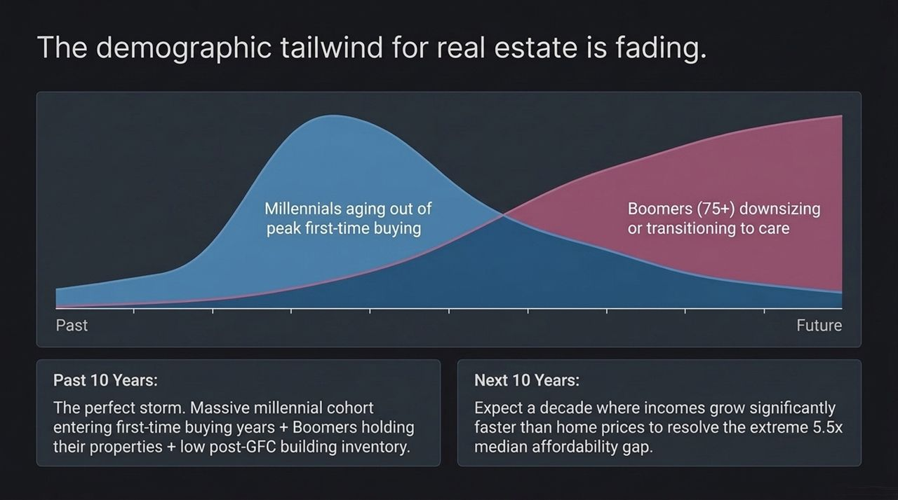
Notes:
Past 10 Years (2015–2025): Perfect storm for real estate price appreciation. Massive Millennial cohort entered prime first-time home buying years while Boomers held onto properties, combined with post-GFC underbuilding.
Next 10 Years: Demographic reversal. The first-time buyer cohort (30-40) shrinks, while Boomers (75+) transition to care facilities or pass housing to children who already own homes.
Affordability Resolution: With home prices at 5.5x median income, expect home price growth to stagnate while income growth gradually closes the affordability gap.

Slide 13
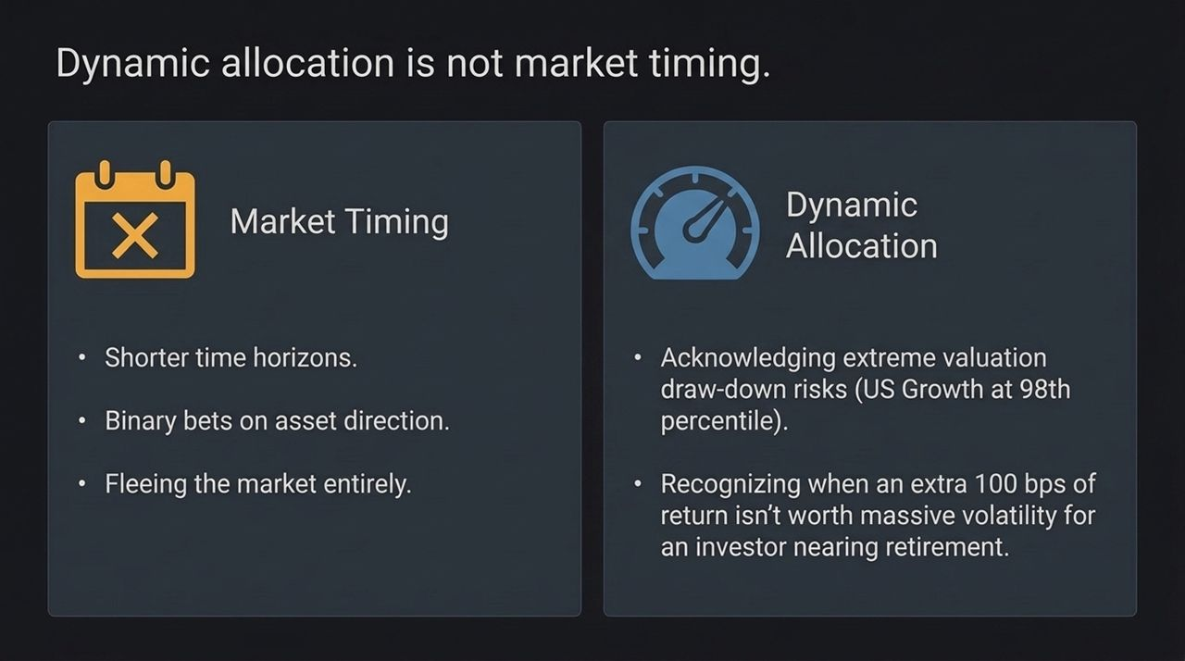
Notes:
Market Timing: Short-term, binary bets on market directions or fleeing to cash.
Dynamic Allocation: Assessing risk-adjusted return distributions over multi-year horizons.
Prudent Risk Management: Acknowledging extreme valuation drawdown risks (U.S. Growth at 98th percentile) and recognizing that an extra 100 bps of return is not worth taking massive drawdown risk for an investor near retirement.

Slide 14
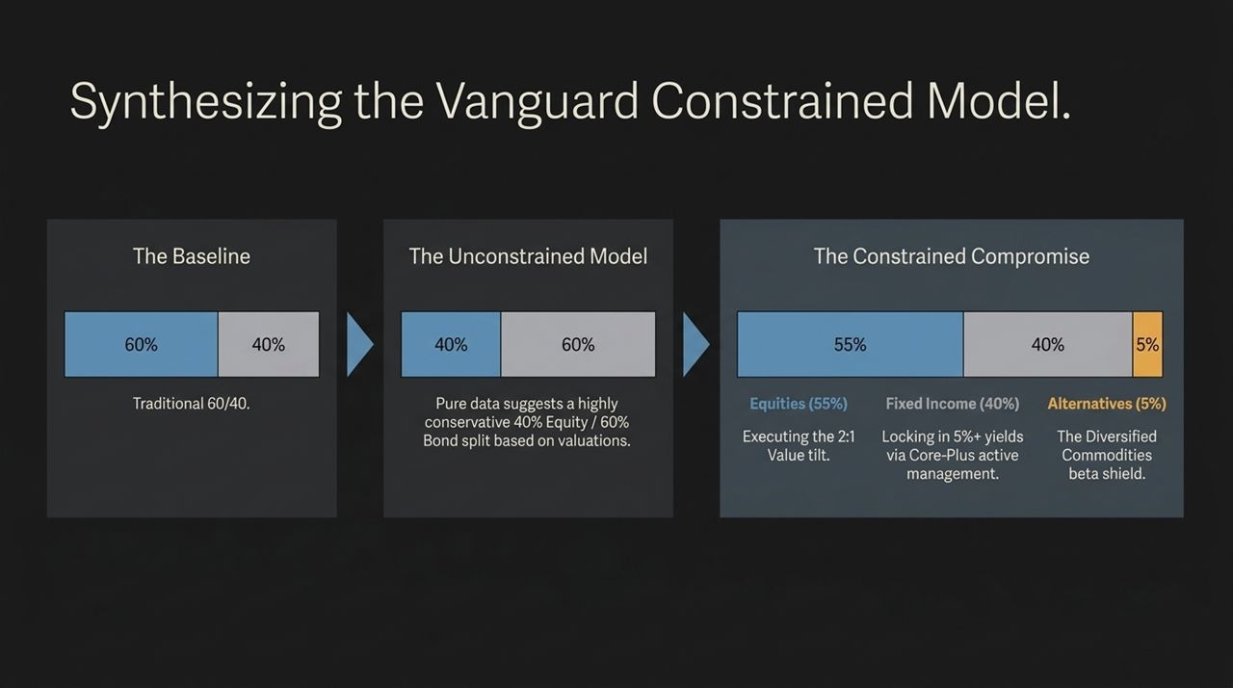
Notes:
https://www.youtBaseline: Traditional 60/40 (Volatile due to Growth concentration and low real bond yields).
Unconstrained Model: Pure mathematical output suggests a conservative 40% Equity / 60% Bond split based on high stock valuations.
The Constrained Compromise (55% Equity / 40% Fixed Income / 5% Alternatives):
55% Equities: Incorporates the 2:1 U.S. Value tilt.
40% Fixed Income: Secures 5.0%–5.5% real yields via active Core-Plus management.
5% Alternatives: Diversified Commodities as an asymmetric inflation shield.
ube.com/watch?v=pliV8FIi0YE

Slide 15
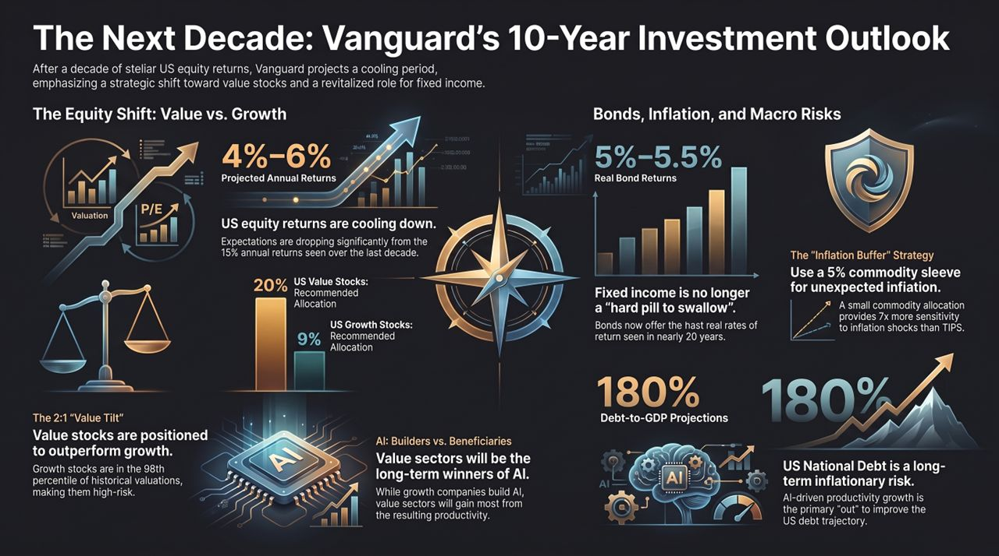
Notes:
Cooling Equities: U.S. total equity returns will average 4–6% per year as valuations contract toward baseline historical norms.
Value Tilt (2:1): Allocate 20% to U.S. Value and 9% to U.S. Growth to capture AI productivity gains while avoiding CapEx bloat.
Fixed Income Revival: Lock in 5.0–5.5% real returns through active core-plus fixed income.
Inflation Shield: Implement a 5% commodity sleeve to hedge against unexpected supply shocks at 7x the capital efficiency of TIPS.
Productivity Engine: Rely on AI productivity growth (+0.5% GDP/year) to anchor long-term debt-to-GDP and keep inflation near 2%.

